Slide 1
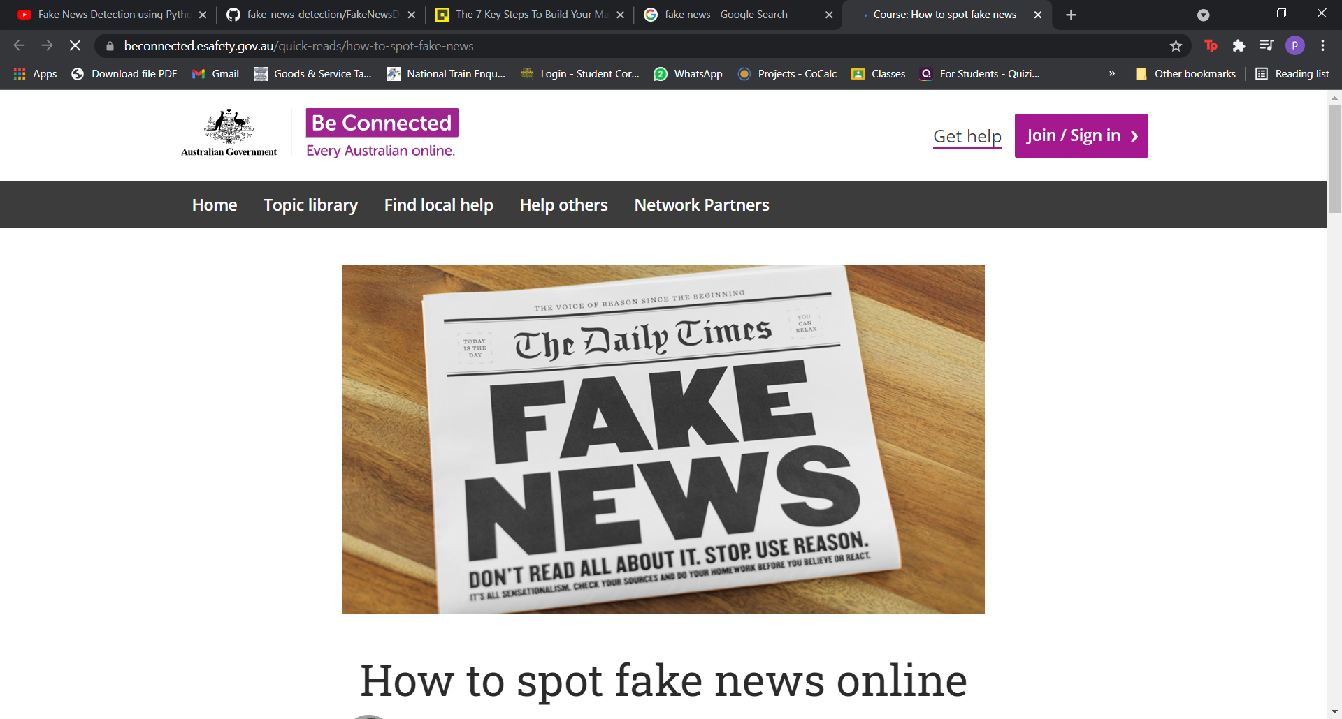
IMPOSTER CONTENT DETECTION
Submitted to - Amir Khan Sir
(Technical Trainer CSE)

Slide 2
Members of team
Ojasva Saxena (191500520)
Pranjal Bansal (191500569)
Soniya Sahu (191500820)
Shriyanshi Patwa (191500790)

Slide 3

WHAT IS FAKE NEWS?
Fake news is news designed to deliberately spread hoaxes, propaganda and disinformation.
It denotes a type of yellow journalism which intentionally presents misinformation or hoaxes spreading through both traditional print news media and recent online social media.
This is often done to further or impose certain ideas and is often achieved with political agendas.
Often fake news will mimic real headlines and twist the story.

Slide 4
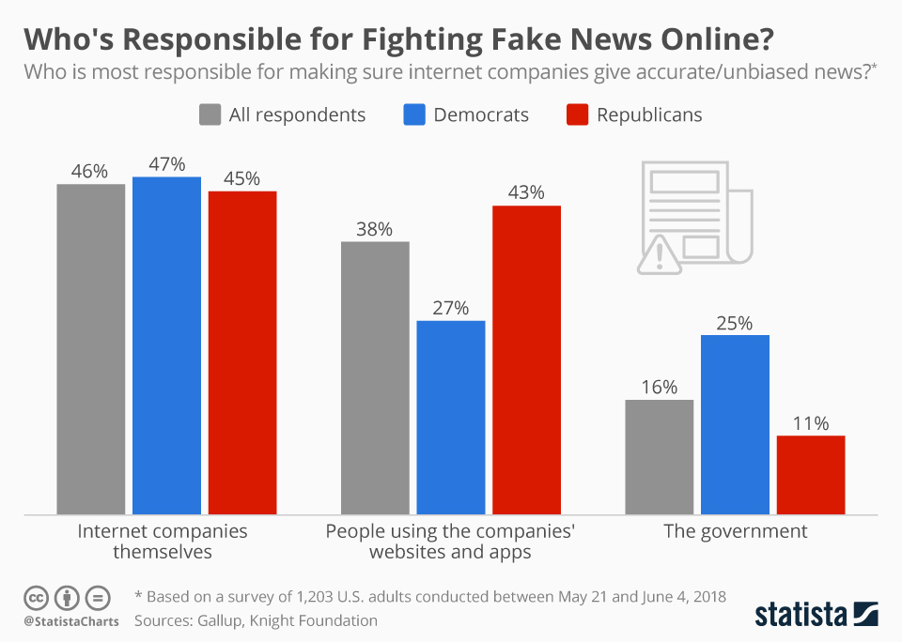
MOTIVATION
The increment of the false news on different websites.
People believing these news and spreading them further.
The government not taking solid actions against it.
Media also playing a vital role in it and not trying to stop it.

Slide 5

How to recognize a Fake News Story?
HOW TO RECOGNIZE A FAKE STORY?
Watch for headline and content typos.
Watch for excessive punctuation.
Watch for biased vocabulary.
Example: “Immigrants” vs. “Illegals”.

Slide 6
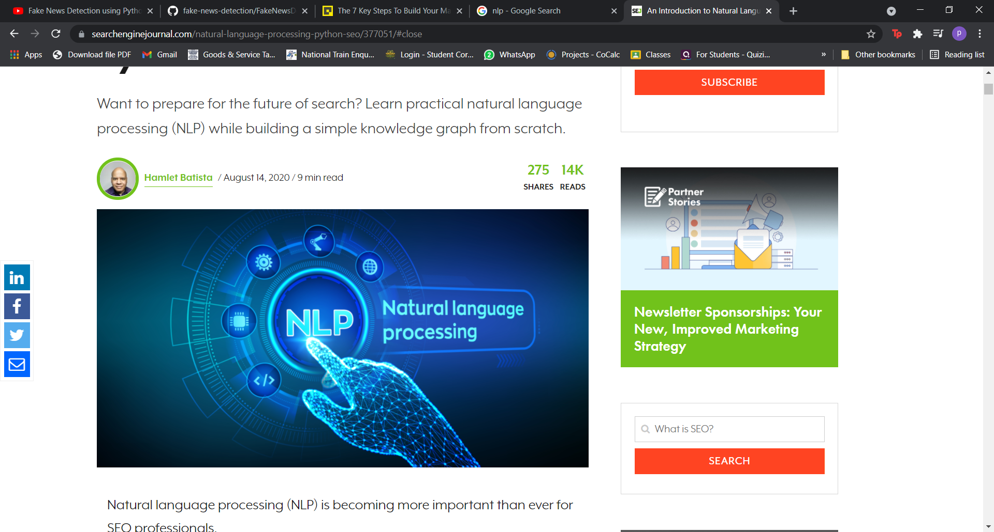
Detecting Fake News With Natural Language Processing(NLP)
DETECTING FAKE NEWS WITH NATURAL LANGUAGE PROCESSING
As human beings, when we read a sentence or a paragraph, we can interpret the words with the whole document and understand the context.
Given today’s volume of news, it is possible to teach a computer how to read and understand the difference between real news and fake news using Natural Language Processing(NLP).The building blocks are Dta Set and Machine Learning Algorithms.

Slide 7
Objective
OBJECTIVE
The project helps to find a way to utilize Natural Language Processing(NLP) to identify and classify fake news articles. The main objective is to detect the fake news which is a classic text classification problem.

Slide 8

PROBLEM STATEMENT
The requirement of a reliable source that can identify unreliable news based on the content provided.

Slide 9
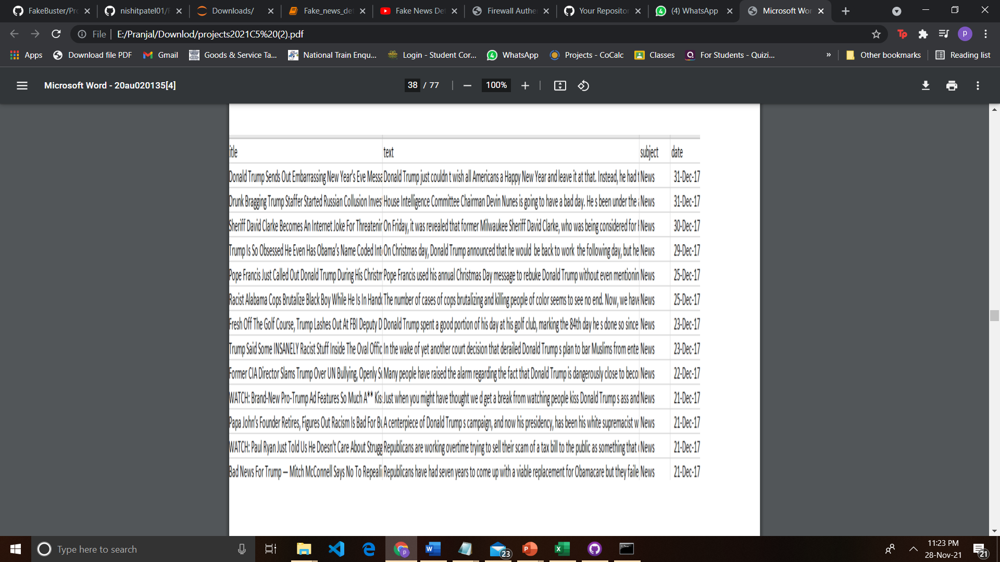
DATA SOURCE
Data Source is – Kaggle
DATA ITEMS- Title, Text, Subject, Date, Class.
Label 1- Unreliable
Label 0- Reliable

Slide 10
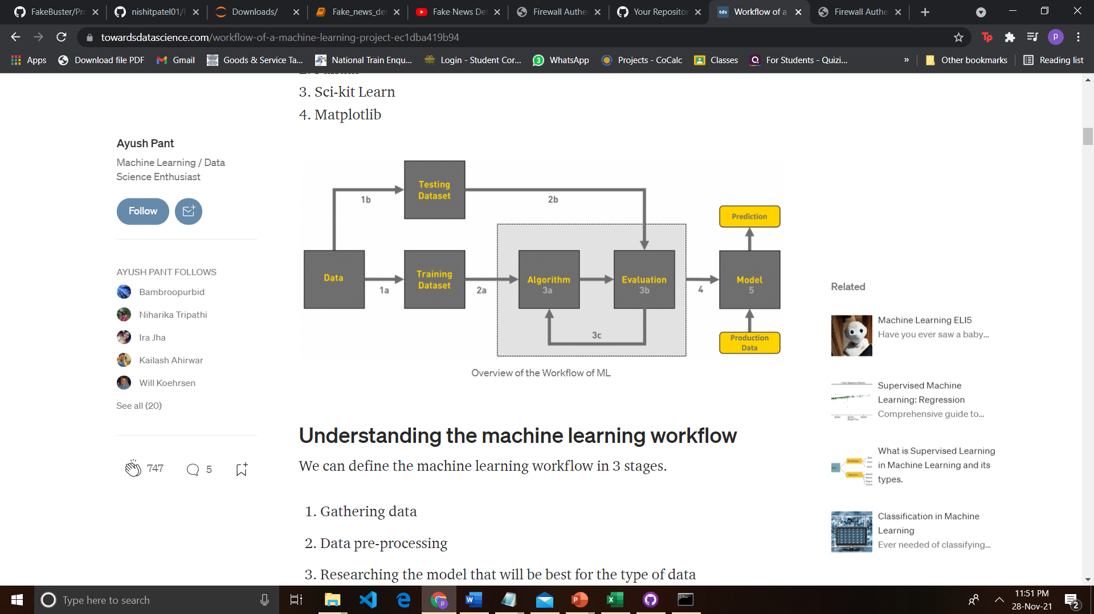
WORKFLOW

Slide 11
The machine learning process consist of following steps:
1)Data collection and preparation, which includes getting the training data, cleaning it and preparing it to the process of features extraction.
2) Feature Selection, which consist of identifying the features that are most useful for the problem.
3) Algorithm choice, given the dataset, after selecting the features, we should choose the suitable algorithm to extract these features from the dataset.
4) Parameter and model selection, which means choosing the machine learning model and setting its parameters to guarantee the best performace with extracted features.
5) Build a model, as given the dataset, algorithm, and parameters, training uses computational resources in order to build a model of the data in order to predict the outputs on new data.
6) Testing the model, as before the model is used, it needed to be tested and evaluated for accuracy on data that it was not trained on.

Slide 12
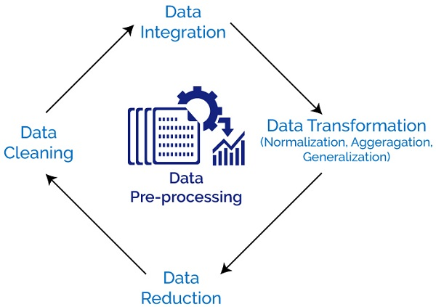
DATA PRE-PROCESSING
To bring your text into a form that is predictable and analyzable for your task.
Tokenization, Stemming, Lemmatization.
Cleaning data in many ways like breaking into small chunks, simplifying tenses and using base form of the word.

Slide 13
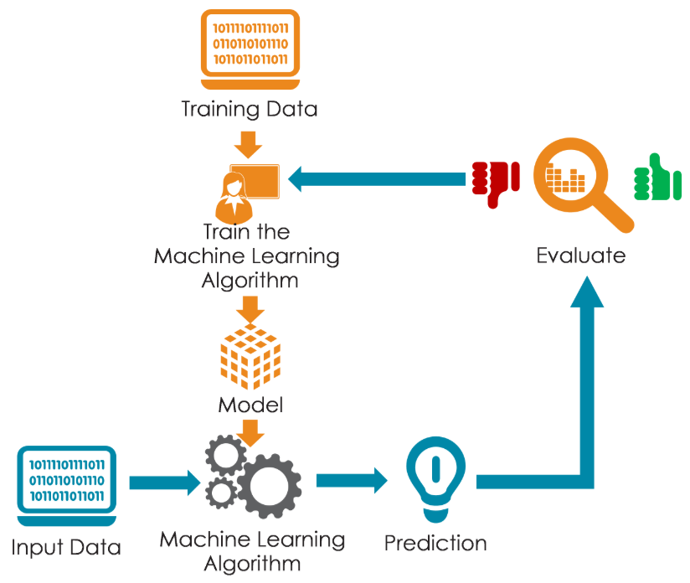
MODELS USED
Naïve Bayes
Support Vector Machine (SVM)
Decision Tree
Random Forest
Logistic Regression

Slide 14
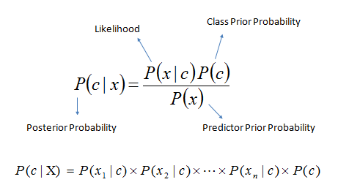
Naïve Bayes
Classification technique based on Bayes’ theorem with an assumption of independence among predictors.
Conversion of data set into frequency table.
Create likelihood table with the help of probability.
Calculating posterior probability using the given formula for each class.

Slide 15
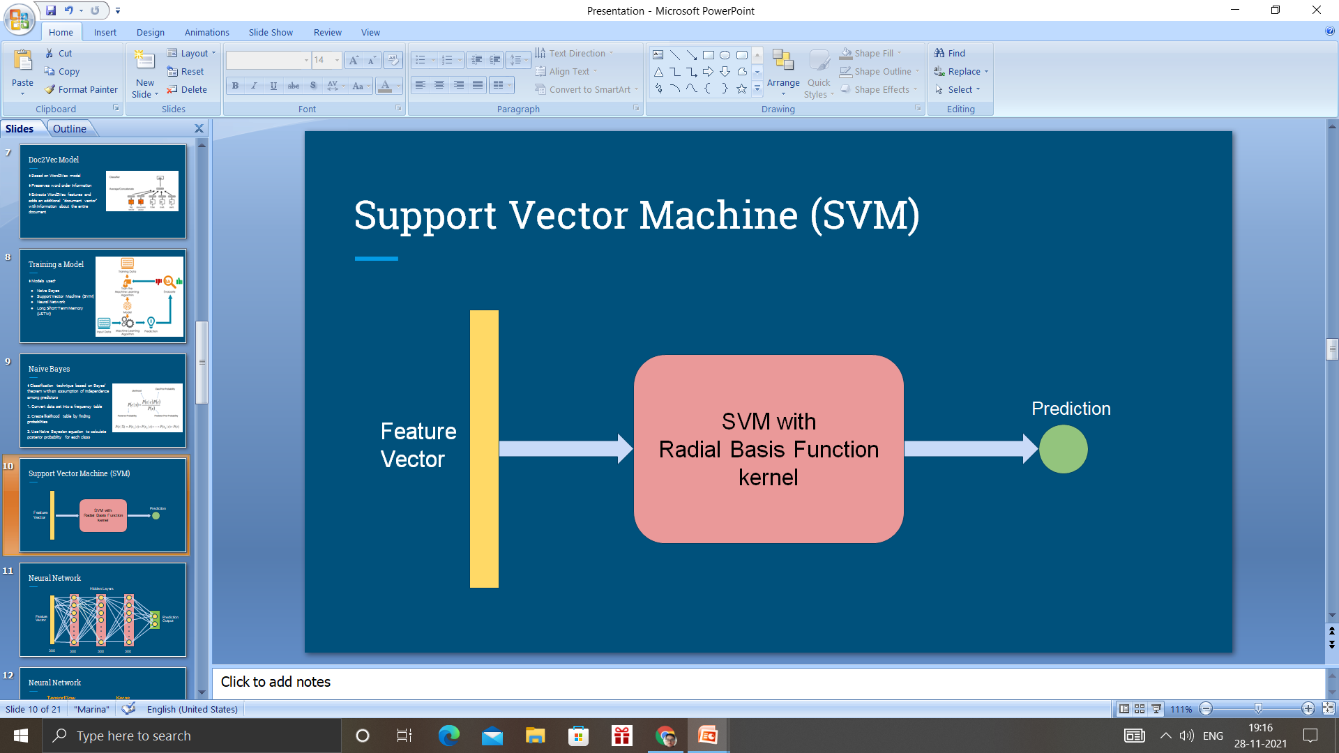
SVM
Support Vector Machine
Used interchangebly using Support vector Network(SVN)
Model is constructed post training of SVM
Distinguish the category for the new data
To find a hyperlane that divides the data in two groups
Notes:
https://www.researchgate.net/publication/334192809_A_Study_on_Fake_News_Detection_Using_Naive_Bayes_SVM_Neural_Networks_and_LSTM

Slide 16

Decision Tree
Contains only numeric and categorical kind of data.
Can’t examine continuous type of data.
Subtree replacement, Subtree Raising.
Notes:
https://www.researchgate.net/publication/350287290_Fake_News_Classification_Using_Random_Forest_and_Decision_Tree_J48

Slide 17

Random forest
Used for classification and regression issues.
Combination of several decision trees.
produces one class and bootstraps the votes to obtain the better accuracy from the technique.
At any node, a decision will be made.
Notes:
https://ijesc.org/upload/ef1625de3da5edd5ced54e70bc68663d.Identification%20of%20Fake%20News%20through%20SVM%20and%20Random%20Forest.pdf

Slide 18
Logistic Regression
Used to predict the probability of a categorical dependent variable.
The dependent variable is a binary variable.
It contains data coded as 1 (yes, success, etc) or 0 (no, failure, etc.).
Predicts P(Y=1) as a function of X
Notes:
https://www.irjet.net/archives/V6/i5/IRJET-V6I5733.pdf

Slide 19
COMPARISON OF MODELS
Model Name | Accuracy
Naïve Bayes | 95.80%
Logistic Regression | 99.10%
Decision Tree | 99.57%
Random Forest | 99.33%
Support Vector Machine | 99.62%

Slide 20
GRAPHICAL REPRESENTATION

Slide 21
CONFUSION MATRIX
Also known as an error matrix.
Table layout that allows visualization of the performance of an algorithm, typically a supervised learning one.
Compares the actual target values with those predicted by the machine learning model.
The name stems from the fact that it makes it easy to see whether the system is confusing two classes.

Slide 22
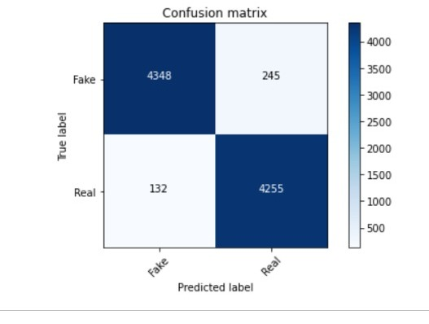
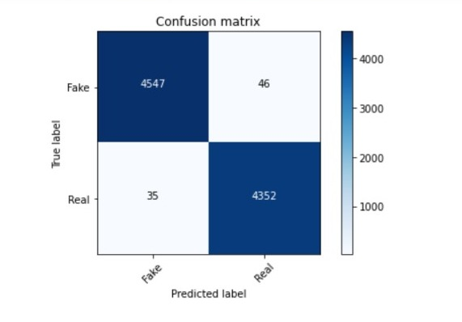
Confusion Matrix
Naïve Bayes
Logistic Regression

Slide 23
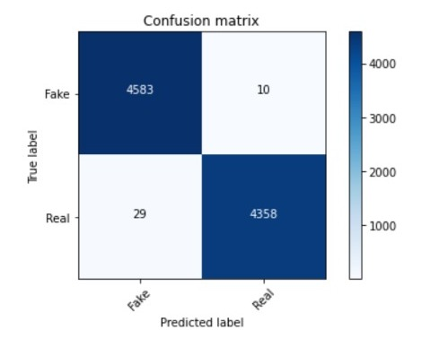
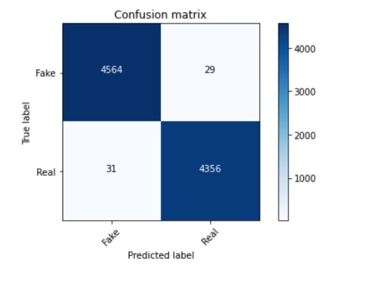
Confusion Matrix
Decision Tree
Random Forest

Slide 24
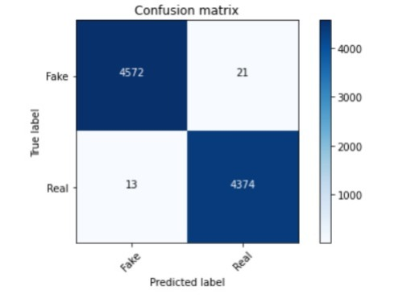
Confusion Matrix
SVM

Slide 25
CHALLENGES FACED
Lack of clean data to directly work with might have slowed down our progress
Content based classification is just a part of the whole picture
Distinguish between click-bait and actual fake news

Slide 26
FUTURE WORK
To add more datasets to check the credibility of our existing system.
Include more algorithms to the current system
Introduce the web version of the existing system with the help of Google flask and web development.

Slide 27

A special thanks to our mentor Amir Khan Sir(Technical Trainer) for providing his assistance to us whenever we required it.

Slide 28
References
Fake News Detection: A Data Mining Perspective
Fake News Identification - Stanford CS 229
BS Detector
Datasets from Kaggle

